Slide 1
ONLINE COURSE
Online course for Farmer Field Schools
on Farmer Seed Production and Marketing

Slide 2
Online course for Farmer Field Schools on Farmer Seed Production and Marketing
This module is authored by Connie Formson, Hilton Mbozi, Jorge Chávez-Tafur, Bert Visser and Myrthe Meeuwissen. This work is part of the Sowing Diversity = Harvesting Security program Phase II (2019-2022). Funding for the program is provided by the Swedish International Development Cooperation Agency (Sida).
CITATION: Oxfam Novib. 2021. Online Course for Farmer Field Schools on Farmer Seed Production and Marketing. The Hague: Oxfam Novib.
CONTACT: Connie Formson | Lead, Farmer Seed Enterprises, Sowing Diversity=Harvesting Security (SD=HS), Connie.Formson@oxfamnovib.nl
Cover picture: © Carlos Zaparolli / Directors ́Board of the certified seed collection center located in Los Lucas farmhouse in Todos Santos Cuchumatanes in Guatemala
DISCLAIMER© Oxfam Novib December 2021. This publication is copyrighted but the text may be used free of charge for the purposes of advocacy, campaigning, education, and research, provided that the source is acknowledged in full. The copyright holder requests that all such use be registered with them for impact assessment purposes. For copying in any other circumstances, or for re-use in other publications, or for translation or adaptation, permission must be secured, and a fee may be charged. Email sdhs@oxfamnovib.nl for more information.
2

Slide 3
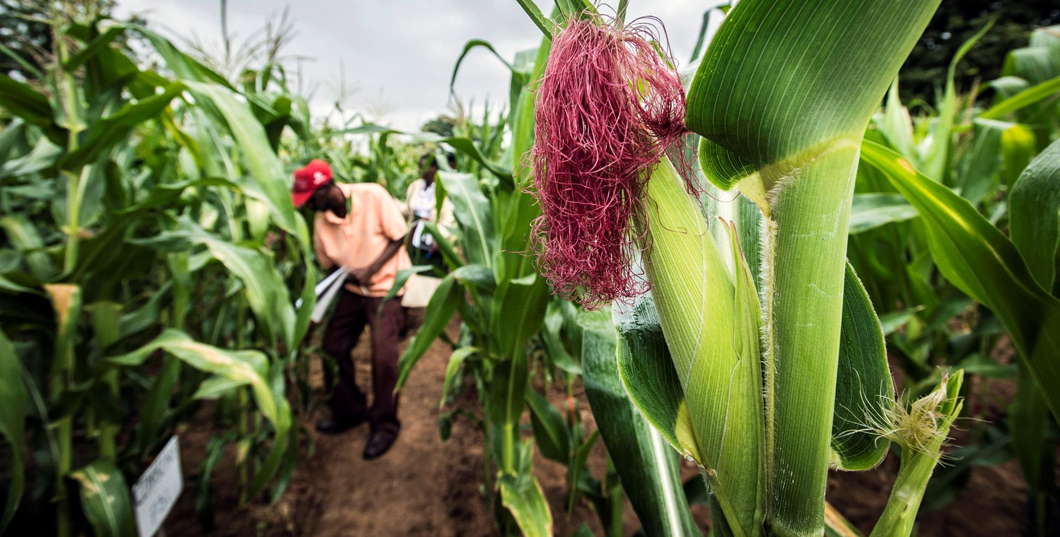
CONTENTS
ContenT
Foreword Learning Objectives
Target Audience
Content
5
7
8
9
Module 1: Introduction
Module 2: Preparatory activities
Module 3: Diagnosis and planning
Module 4: Analysis of the seed market and crop selection
Module 5: Introducing seed business concepts and policy issues
Module 6: Seed production
Module 7: End-of-season evaluation and next-season planning
10
11
12
13
14
15
16
Questions & Answers
17
acronyms
FSE Farmer Seed Enterprise
FFS Farmer Field School
ToT Training of Trainers
SD=HS Sowing Diversity = Harvesting Security
Sacha de Boer © Field Maize in Zimbabwe.
3

Slide 4
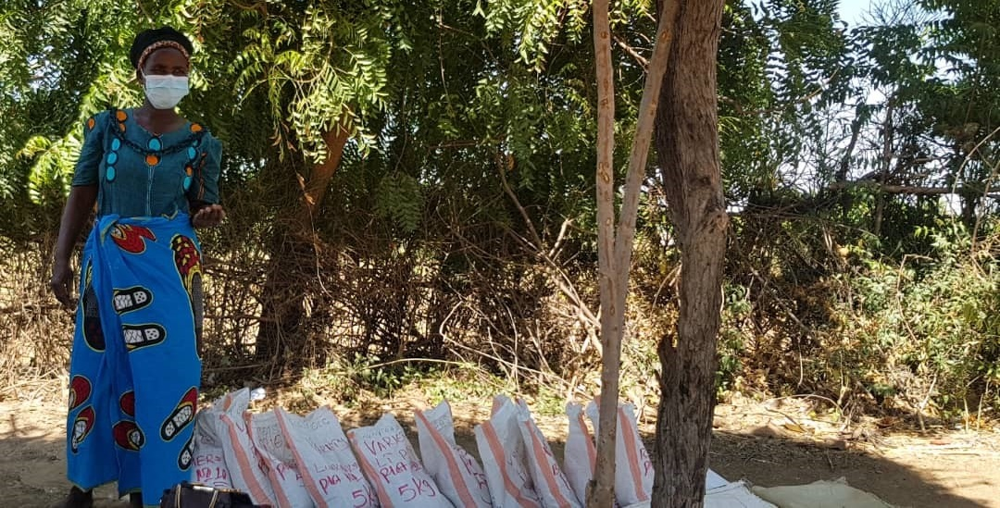
FOREWORD
Juliet Nangamba, CTDT-Zambia © Mrs. Sofia Siachisumpa, farmer giving feedback on cowpea advance lines and the local variety during the evaluation of the FFS materials.
4

Slide 5
INTRODUCTION
The “Sowing Diversity=Harvesting Security” Program (hereafter, SD=HS) is a global program currently implemented by partner organisations in eight countries and coordinated by Oxfam Novib.
The online course “Farmer Field Schools on Farmer Seed Production and Marketing” is part of the program’s work on seed production for the local market.
The objective of this work is:
(1) to improve farmers’ access to seed of well adapted crops and varieties which are unaffordable in the formal seed sector, and
(2) to enhance the livelihoods of farmer seed producers.
The focus is on strengthening local markets and farmers’ understanding of how markets work. Maintaining the Farmer Field School (FFS) approach, farmers previously involved in FFS on Participatory Plant Breeding or on Local Food Plants for Nutrition will gain technical knowledge on producing seed on a commercial level.
The course has been developed by the SD=HS team in collaboration with our partners Participatory Ecological Land Use Management in Uganda (PELUM Uganda) and Champion Farmer Seeds Cooperative in Zimbabwe.
This course builds on:
Farmer Field Schools Guide on Seed Production and Marketing
Toolkit for the FFS Guide on Seed Production and Marketing
Seed Production Tools for Farmer Field Schools
Documentation Form FFS on Seed Production & Marketing (KOBO)
Empowered and resilient farming communities Support for commercialization of selected crops with market value and importance to smallholder farmers is part of the overall focus of SD=HS on crop diversity and resilience in the context of climate change. Work on seed production and marketing in farmer field schools on participatory plant breeding, in particular, helps ensure that farming promotes resilience and is remunerative.
We are grateful for funding support from the Swedish International Development Cooperation Agency (Sida).
We hope that this course will be helpful and are open to comments and suggestions for its improvement at any time.
5

Slide 6
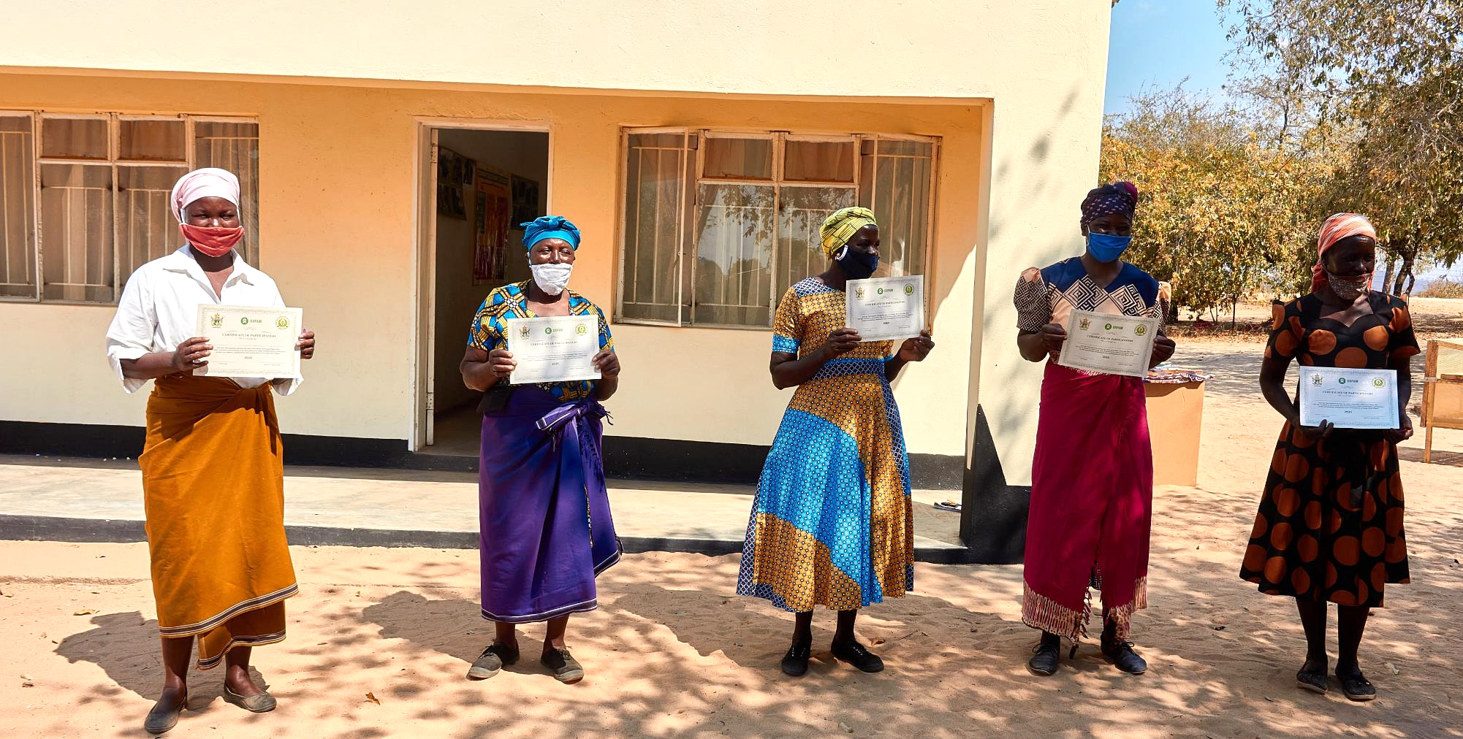
LEARNING OBJECTIVES
CTDT Zimbabwe © Women with their certification of participation during the CTDT Seed fair, Chimukoko Mudzi, Zimbabwe
6

Slide 7
LEARNING OBJECTIVES
This online course has been organized in order to support partner organisation staff, as well as potential master trainers, in preparing and conducting the ToTs for the subsequent FFS on Farmer Seed Production and Marketing that started in the SD=HS Program in 2021.
We anticipate that online course trainees will later become national ToT trainers, who will train a larger number of first-generation local FFS facilitators. Hence, the main aim of the course is in-country capacity building. During the online course participants get familiar with the content and delivery methodology of the FFS Field Guide on Farmer Seed Production and Marketing.
By the end of this online course participants will have gained an understanding of:
- How to conduct a ToT for FFS on seed production and marketing,
- Technical requirements of producing seed at a commercial level, and
- How to undertake seed production as a “business”.
By participating in the ToTs participants will support FFS members to:
- Become technically capable, reliable and self-confident seed producers;
- Understand how seed markets work and develop the skills, knowledge and linkages to capitalize on market opportunities; and
- Connect farmer seed production and marketing with other components of the SD=HS program on PPB, nutrition and local food plants, and policy.
Farmer field school methodology
The FFS concept is based on community empowerment and the capacity of community members to learn from each other and increase their self-confidence and self-reliance. It is important that FFS facilitators embody such an approach, helping communities to resolve their challenges themselves. While this online course aims to prepare people who will lead the ToTs, community knowledge can be generated and used only in experiments and discussions among community members, assisted by their FFS facilitators and local experts as needed. This online course is to be considered as an additional resource when preparing for the face-to-face ToT in country, and the refresher ToT in subsequent seasons.
The FFS is a powerful approach to enhance the seed production and marketing skills of farmers because it provides a platform for joint learning irrespective of how farmers choose to organize themselves after having completed the FFS. Farmers who learn jointly in the FFS, may choose to operate as individual producers, may operate informally in community groups, or take concerted steps towards establishing farmer seed cooperatives in the medium to long term.
7

Slide 8
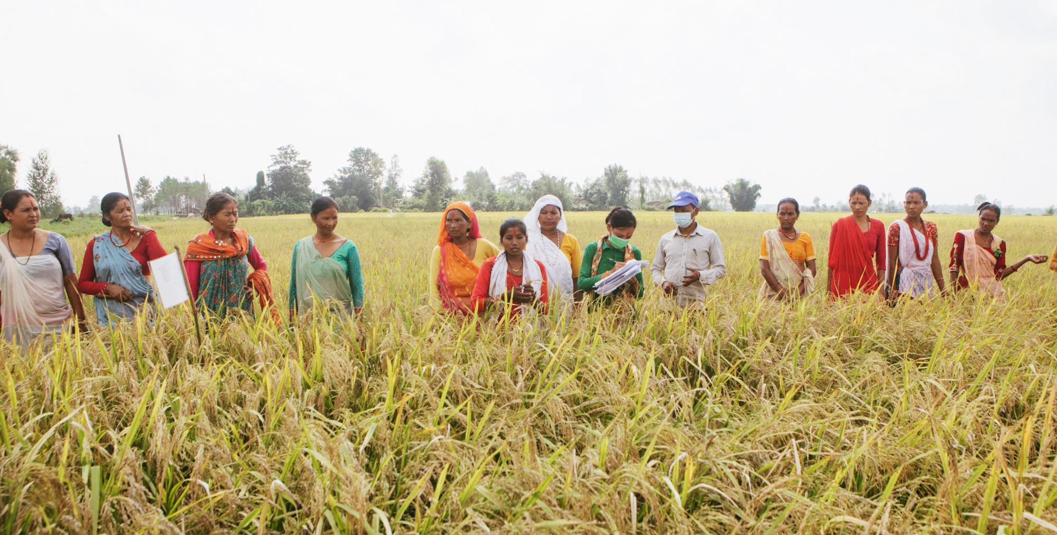
TARGET AUDIENCE
TARGET AUDIENCE
Partner organisation staff, and Master Trainers or lead farmers, extensionists, seed business experts, government staff of local seed centres, who are potential master trainers and responsible for organizing and conducting the ToT for FFS on Farmer Seed Production and Marketing. The main requirement for a ToT participant is the motivation to improve access to seeds of adapted crops and varieties in full respect for agro-ecosystem requirements under changing climate conditions.
Prashit Sthapit © Members of the Laliguras Farmer’s Field School, Joshipur in Nepal, working in the field where they have planted many varieties of paddy to determine which one suits the local environment the best.
8

Slide 9
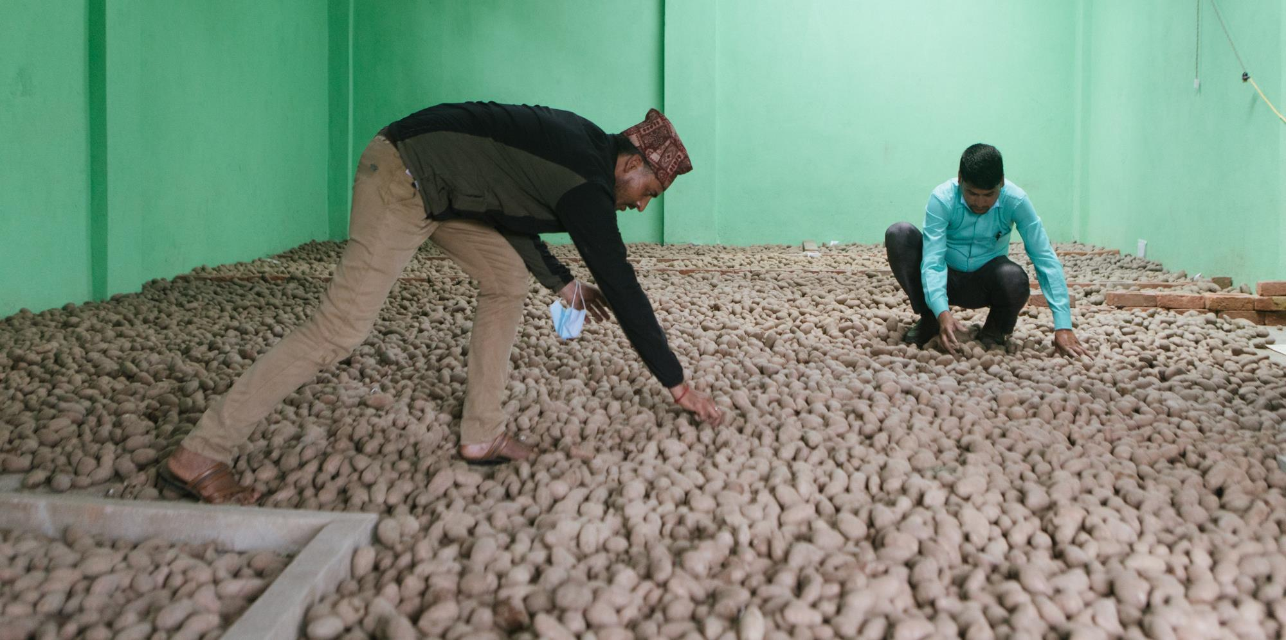
MODULES
CONTENT
This course is moderated by several facilitators from within the program, representing the global nature of our work. The course is distributed over seven modules and includes presentations and videos. The presentations have been designed to be used directly in the ToTs, with questions to guide discussions. Studying the materials will require an investment of 3-4 hours per module depending on the module in question. Finally, the course includes a section on questions and answers compiled from online discussions.
Prashit Sthapit © Ganesh Bista, Manager and Kabiraj Dangi, Chairperson of Jaibikbibhidhata Conservation Agriculture Cooperative (Ghanteshwor community seed bank) in their cold storage in Gaira, Doti, Nepal.
9

Slide 10
MODULE 1
Introduction
Module 1 - Introduction
This module introduces participants to the course. It refreshes some course participants on the Farmer Field School approach and the general principles of adult learning. Course participants will appreciate how the guide is structured, the purpose of seed production and marketing FFS is explained. Participants will learn that with the knowledge generated in the FFS, farmers take decisions on commercial seed production that will improves access to appropriate seed for their fellow farmers within their communities and beyond.
The module highlights Farmer Field School principles that contribute to building critical thinking, self-confidence, increased capacity for experimentation and decision making among those who participate in the FFS.
Finally, the module notes that this course integrates with other courses under the SD=HS program and the Field guide on seed production and marketing is not a stand-alone document. It borrows from tools and activities developed under the PPB and nutrition and local food plants FFS designed to empower communities leading to them making decision to produce seed for sale.
Online course participants are invited to read the parts of the Field Guide that deal with the topics referred to above and in the corresponding tables of each module.
Topics Module 1 | Corresponding sub-chapter in FFS Guide
Facilitators introduction
Introduction and Purpose | 1.1
Why develop farmer seed production and marketing capacity? | 2.3
For whom is the guide intended? | 1.2
Organization of the guide | 1.3
Principles of the Farmer Field School | 1.4
Integrated trainings: various SD=HS FFS Topics | 1.5
Additional resources
Video: Participatory Plant Breeding Uzumba Maramba, Zimbabwe (CTDO)
10

Slide 11
MODULE 2
Preparatory Activities
Module 2 - Preparatory Activities
This module provides guidance on the preparatory process which include a 5 to 6 days Training of Trainers’ workshop as a first step towards implementation of the FFS on Seed Production and Marketing. The ToT may involve external resource persons and experts who contribute to specific topics. The ToT requires a strong commitment and sufficient time with which to facilitate a minimum of one FFS cycle within a growing season.
In addition to facilitating the ToT preparatory activities to be undertaken include community awareness meetings.
In this module participants also reflect on the involvement of youth alongside gender equality and equity in the development of a robust Farmer Seed Enterprise, and in an FFS context. Within the program, a separate Gender Journey module is available for implementation within an FFS.
Topics Module 2 | Corresponding sub-chapter in FFS Guide
Training of Trainers | 2.1
Organizing the ToT | 2.2
The impact of gender relations | 2.4.1
The position of youth | 2.4.2
Additional resources
Reading: ISSD (2013) Gender study for seed sector development Uganda
Reading: CGIAR (2020) Gender Dynamics in Seed Systems Development
Reading: SD=HS Gender Journey Module
Gender exercises: from the FFS Field Guide on Nutrition and local food plants
11

Slide 12
MODULE 3
Diagnosis and Planning
Module 3 – Diagnosis and Planning
In this short module participants should note that the diagnostic phase is a crucial step to ensure that the FFS addresses the primary needs for quality seeds identified by the farmers in the community. This phase is not only diagnostic in nature but is also characterized by a joint learning process that involves farmer’s sharing of experiences and results gained in PPB and local food plants and nutrition FFS.
The diagnostic phase of this FFS serves to analyze the options (strengths and weaknesses; opportunities and threats) for seed production and marketing of specific crops and varieties. The module has exercises which help participants to understand the potential seed requirements and market opportunities for the FFS. The diagnosis exercises will also help participants to have insights about the current status of seed production in the community subsequently helping them to look into the future (visioning) resulting in the development of a common Action Plan for Seed Production and Marketing that will drive the subsequent FFS sessions. Participants should note that the Action Plan completes the Diagnostic Stage.
Topics Module 3 | Corresponding sub-chapter in FFS Guide
Diagnosing potential seed requirements and market opportunities | 3.1
Initial crop selection | 3.1.1
Visioning and Action planning | 3.2
Revisiting group structures | 3.4
Additional resources
Reading: Participatory tools working with crops, varieties and seeds
Exercises and Tools: Participants are encouraged to review and make use of the following: - Initial Crop Identification Tool - Visioning exercise and - Action plan for each FFS group
12

Slide 13
MODULE 4
Analysis of the Seed Market and Crop Selection
Module 4 – Analysis of the Seed Market and Crop Selection
The aim of this module is to help farmer groups gain the basic skills required to make decisions regarding what seeds to produce commercially. This module supports the FFS group to assess: - which crops and varieties have market potential, - the extent to which seed production and marketing can improve their livelihoods either individually or as a group and - obtain a clear sense of all key actors involved in seed markets.
The module guides participants on how to undertake the necessary market research to determine which seed crop or variety to produce. This module of the ToT should include a visit of FFS participants to a local seed market.
Topics Module 4 | Corresponding sub-chapter in FFS Guide
Understanding the seed value chain | 4.1
Market research | 4.2
Understanding costs and benefits of seed production and marketing | 4.3
Revisiting crop and variety selection | 4.4
Additional resources
Reading: Ferris et al, 2014 Linking Farmers To Markets MEAS Discussion Paper
Exercises and Tools: Participants are invited to carry out the following exercises and make use of the Tools supporting FFS activities - Seed business model canvas - Profitability analysis - Cost Benefit Analysis - Crop selection tools
Reading: MEAS Brief 4 - Linking Farmers to Markets - 2014
Reading: ISSD Technical Note 3_- Seed Value Chain Analysis
13

Slide 14
MODULE 5
Seed business concepts and policy
Module 5 –Seed business concepts and policy
In this module the FFS is taken through business principles that they will need to professionally manage their seed production and marketing activities at an individual level or as a group. The aim of this module is to help farmer groups gain the basic skills to optimize their limited resources towards commercial seed production, how to get their seed to the marketplace and to market their produce.
Participants will appreciate that planning is crucial for successful business. Business plans focus on the resources that farmer groups will use, where these resources will come from, how they will operate to bring their seeds to the market, and –in general -how to manage their endeavors in a professional manner.
Also, farmers discuss their marketing strategy in relation to the four Ps, i.e. Product, Place, Promotion and Price. The marketing strategy is a planning tool that describes products and services and explains the position and role of products and services in the market, it profiles customers and competitors and identifies marketing tactics. Furthermore, farmers discuss the consequences of the national seed related laws.
Finally, farmers discuss the basics of contract negotiation in any buyer and seller relationships they may engage in.
Topics Module 5 | Corresponding sub-chapter in FFS Guide
Business planning | 5.1.1
Record keeping | 5.1.2
Promoting and marketing your seeds | 5.2
Negotiation skills and contracting | 5.4
Seed legislation | 5.3
Additional resources
Reading: Support for farmer-led seed, ISSD Africa 2017
Reading: Seed law study, Oxfam Novib 2017
Exercises: Participants are invited to carry out the following exercises - Seed Business Planning
- Reflection on contract farming
- Seed Legislation
14

Slide 15
MODULE 6
Seed Production
Module 6 – Seed Production
This module focuses on efficiently producing high-quality seed of selected crops and varieties that fulfils internal and/or external marketing requirements. Focusing on identity (is it what it says it is?), viability (higher germination rate), purity (no contaminants to any large extent), and health (no pests and diseases in the seed lots).
It looks at all field activities that are associated with seed production for the market. Note that farmers should already have discussed the choice of crops and varieties for which they wish to produce and market their own seeds, as outlined in module 4. Remember that a seed business works best for crops and varieties that have a high or moderate seed demand.
The success of the FFS on seed production and marketing depends entirely on the quantity and quality of the seed produced, that is why field activities need the best preparation possible. In this module all major field activities are distinguished and discussed. Farmers who participated in a FFS on PPB or Nutrition will be familiar with some activities in this module. During the growing season a number of FFS sessions will serve to attain the goals of seed production set by the group before the season onset.
The Weekly Observation Form in the Seed Production Toolkit is to be used for field monitoring and will help FFS participants to follow crop development and seed setting and maturation. Field activities, harvesting, processing and storage, seed inspection and proper transport to the marketplace will be discussed.
Topics Module 6 | Corresponding sub-chapter in FFS Guide
Managing risks in field operations | 6.1
Plot selection and management | 6.2
Plot preparation and seed management | 6.3
Sowing conditions | 6.4
Use of fertilisers and pesticides, soil management | 6.5
Growth phase | 6.6
Harvesting and evaluation of seed production | 6.7
Seed processing and storage | 6.8
Seed inspection and certification | 6.9
From the field to the marketplace | 6.10
Additional resources
Tools: Seed Production Toolkit
15

Slide 16
MODULE 7
Evaluation and Planning
Module 7 – End-of-season Evaluation and Planning
This module responds to the need to identify what went well what didn’t during the different FFS sessions, helping list those issues that need to be improved. At the same time, it responds to the need to show progress towards the original goals. This can help those directly involved in the FFS decide what to do next and continue working together.
But it is important to emphasize that a monitoring and evaluation process (M&E) is not a one-time activity, or an activity that only takes place at the end of an FFS. On the contrary, every session has already had some M&E elements, and these have to be “recovered” here. M&E is an ongoing and continuous effort: there is a need to measure progress with every module and every session, and it is thus necessary to collect information and to analyse it regularly (as a set of steps that can help improve the next session). The end of all FFS activities is an important moment to put all these pieces together and look at the cycle long process: this provides the best inputs for deciding how to continue (or if to continue or not).
Just as important is to highlight that this is a participatory process, involving all members of the group, and with the aim of empowering participants to initiate the process and take corrective action. The facilitator plays a key role here, though not as evaluator. He or she can help or support the process, ensuring that everyone participates and that this leads to better results.
Topics Module 7 | Corresponding sub-chapter in FFS Guide
Monitoring and evaluation | 7.1
End-of season evaluation | 7.2
Planning | 7.3
Additional resources
Reading: CARE, 2018. FFBS Toolkit. Ch. 6, Monitoring, evaluation and learning tools
Reading: ISSD, 2015. Supporting local seed businesses. Topic 1.4, Developing an M&E system
Exercises and Tools: Evaluation and Planning tools
16

Slide 17
Key Resources
Four key documents support the implementation of FSS on seed production and marketing:
Farmer Field Schools Guide on Seed Production and Marketing
Toolkit for the FFS Guide on Seed Production and Marketing
Seed Production Tools for Farmer Field Schools
Documentation Form FFS on Seed Production & Marketing (KOBO)
How do they come together? The table highlights the tools available for application within the FFS.
Topic | FFS Chapter Guide | Tool within Toolkit
Diagnosis and planning
Diagnosis potential seed requirements and market opportunities | 3.1 | 0. Initiation crop identification tool
Analysis of the seed market and crop selection
Understanding the seed value chain | 4.1 | 6. Seed value chain mapping and analysis
Market research | 4.2 | 7. Market research tools
Understanding costs and benefits of seed production and marketing | 4.3 | 8. Profitability analysis
Revisiting crop and variety selection | 4.4 | 9. Crop selection tools
Business planning | 5.1 | 10. Business canvas tools
Record keeping | 5.1 | 11. Record keeping tools
Seed production
Seed production | 6.1 | Attached Seed production tool
Packaging |  | 13. Seed label information
Monitoring and evaluation | 7.1 | 14. FFS self-assessment tool
End-of-season evaluation | 7.2
7

Slide 18
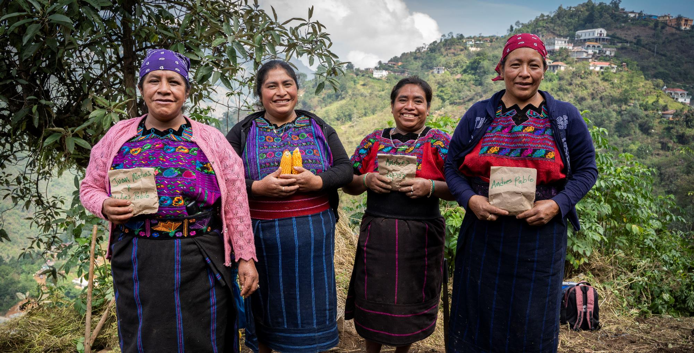
The SD=HS program is grateful for the funding support of the Swedish International Development Cooperation Agency (Sida).
Carlos Zaparolli © Left to right: Cleta Ramírez López, Susana Matías Ortíz, Ana Martín Jeronimo and Isabel Matías holding maize seeds. Los Ramírez Aldea Chaluitz Community, Todos Santos Cuchumatanes in Guatemala

